Slide 1

NOTE: To change this logo image with your own.
1- Right Click on top of the faded image.
2- Choose “Change Picture” 3- Choose option “From File” 4- Locate file and Open
TM STYLE
HOUSING

Slide 2


NOTE: To change this logo image with your own.
1- Right Click on top of the faded image.
2- Choose “Change Picture” 3- Choose option “From File” 4- Locate file and Open
NAME: TOM OMORO
PROJECT: TM HOUSING
SMALL DESCRIPTION
This is for demonstration purposes to show you what the text would look like in this position.

Slide 3



PROBLEM DEFINITION
YOUR SUBTITLE
Students and Youths face significant challenges in finding affordable ,safe and convenient housing options near their educational institutions
The esisting house search process is often time-consuming,frustrating and lacks transparency
A user-friendly web application like TM HOUSING can address these challenges by providing comprehensive house listings ranging from juja,karen,imaara daima and parklands ,add to cart functionality and search processes to make it easier to find specific houses.

Slide 4


NOTE: This may look strange and cluttered, but it plays and looks differently in slideshow mode, (hit F5 to play) So change the text and what you need…then push play to see the results.
Solutions
COMPREHENSIVE DATABASE
Create a comprehensive database of available housing options near schools
ADD TO CART
Streamlined booking process which allows users to easily select and reserve properties making booking process more efficient
SEARCH FUNCTIONALITY
This is for demonstration purposes to show you what the text would look like in this position. Be sure when you tell your story or point that your audience is engaged.
DETAILED INFORMATION
Providing detailed information about each property including photos ,pricing and description.
USER FRIENDLY INTERFACE
Has a user friendly and intuitive interface for searching and browsing housing options

Slide 5
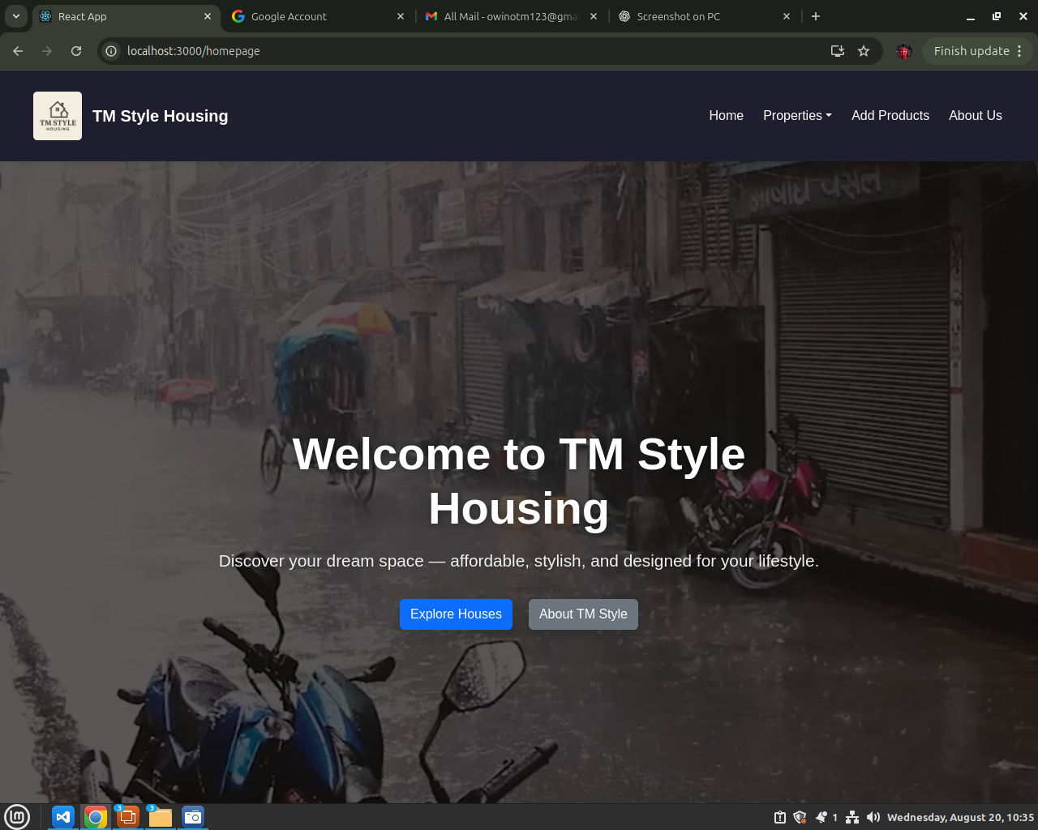
Screenshot of Homepage;

Slide 6
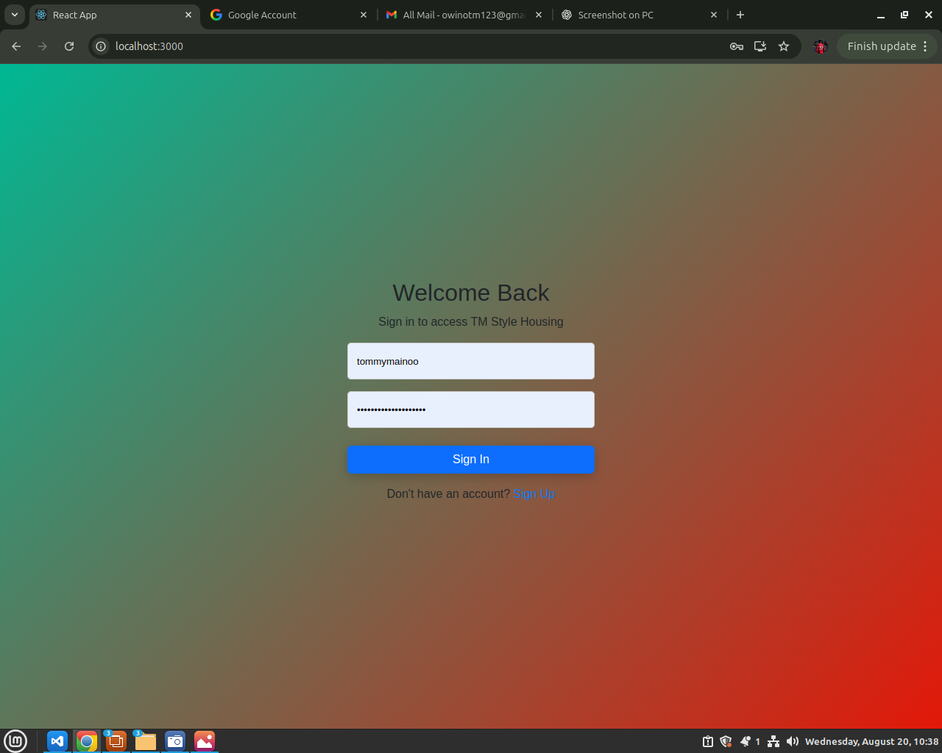
Screenshot of SignIn page;

Slide 7
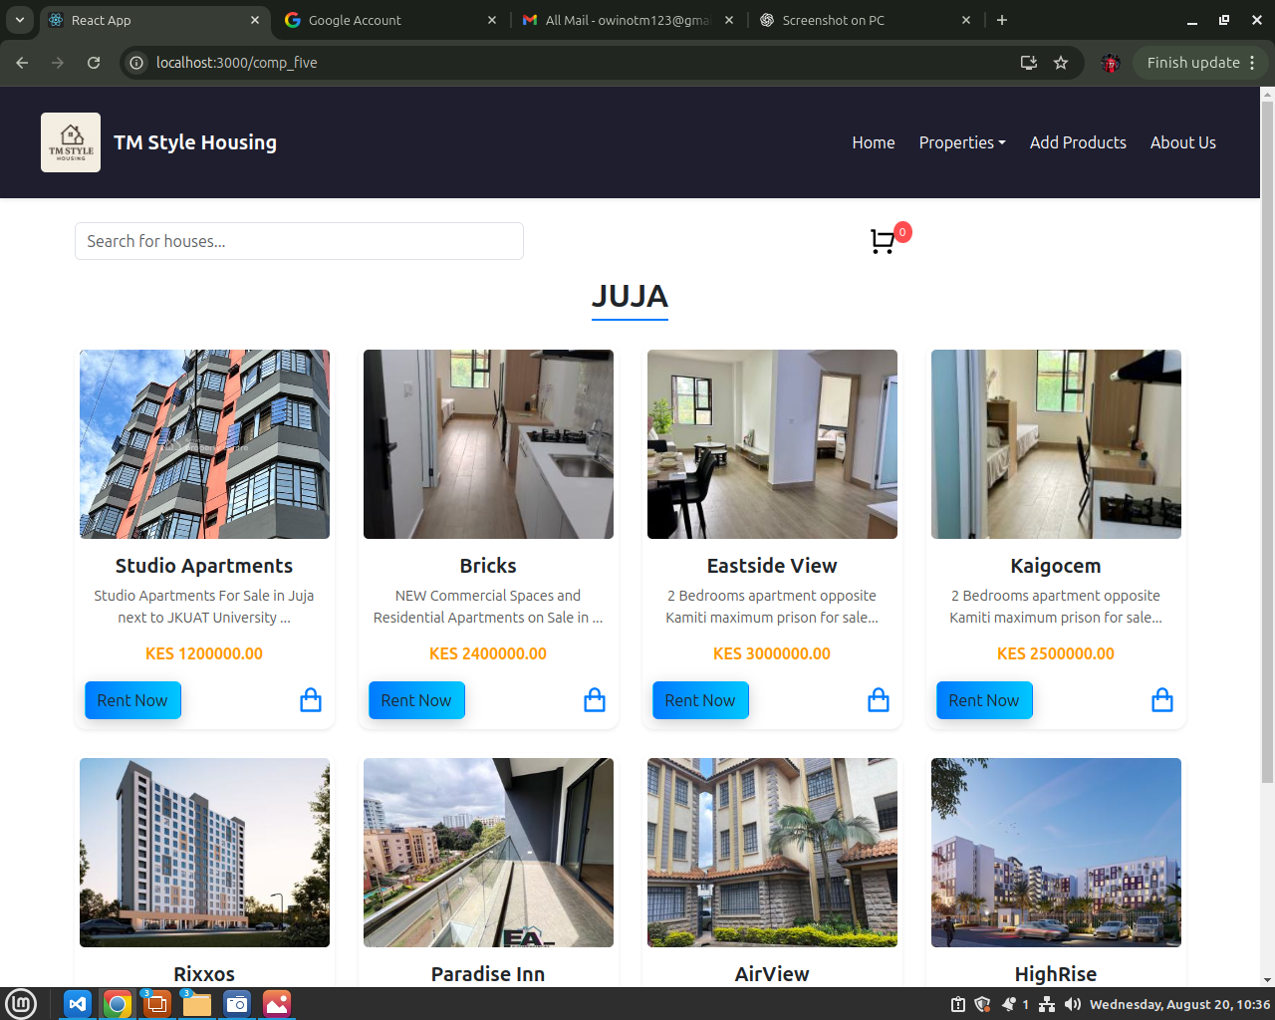
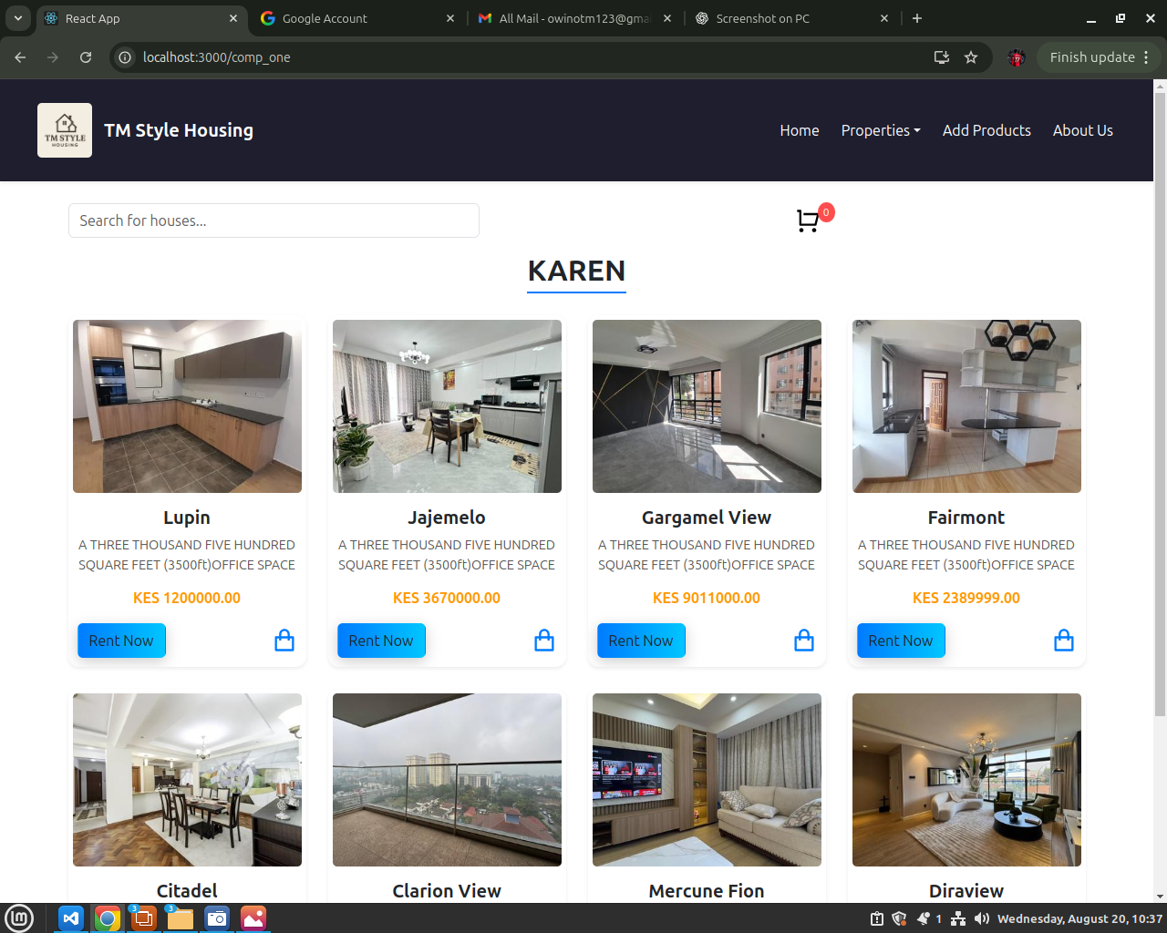
Screenshot of JUJA and KAREN;

Slide 8
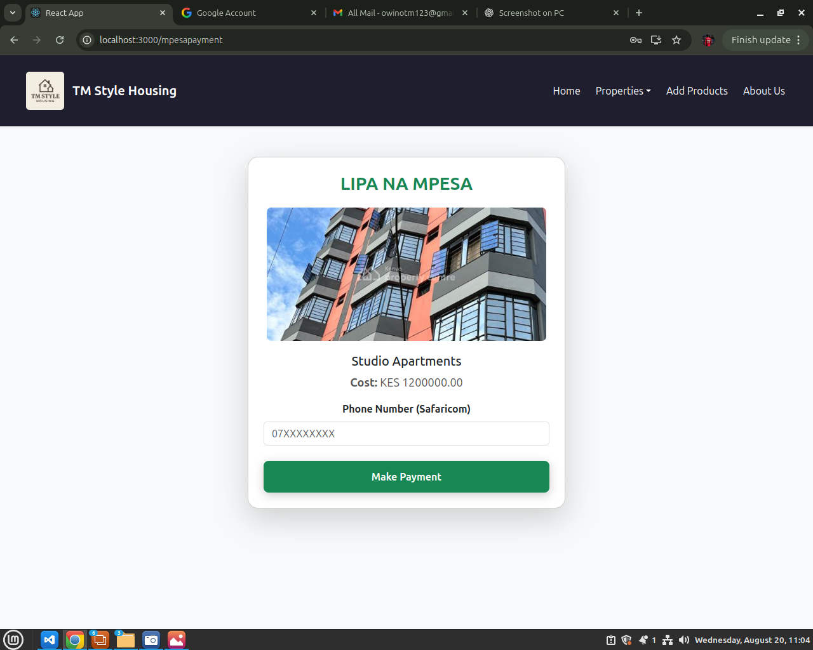
Screenshot of MpesaPayment page;

Slide 9
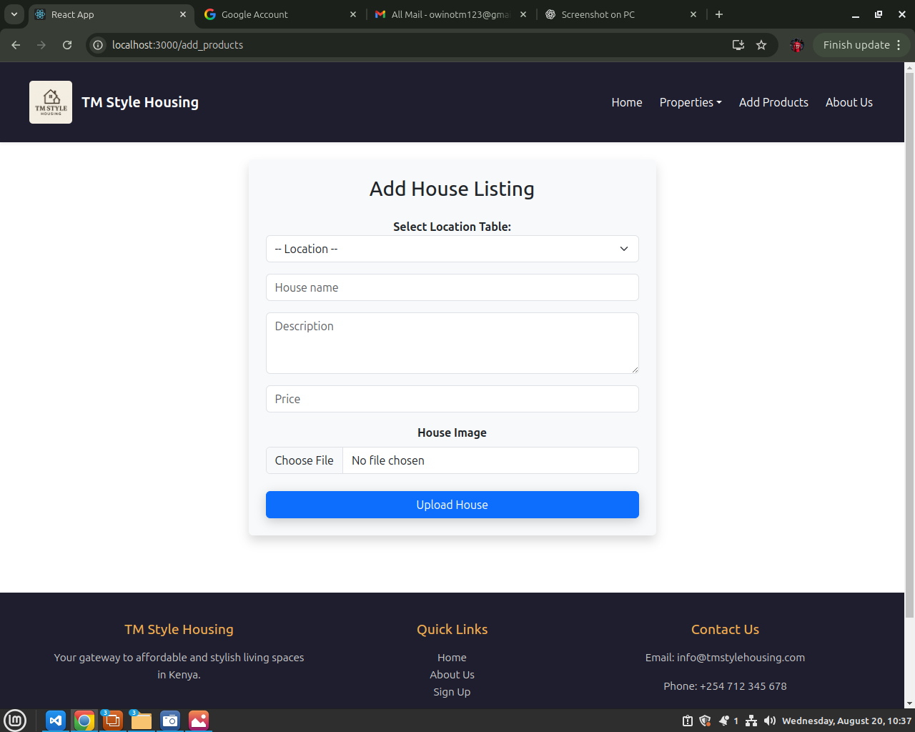
Screenshot of Add houses page;

Slide 10


NOTE: To change this logo image with your own.
1- Right Click on top of the faded image.
2- Choose “Change Picture” 3- Choose option “From File” 4- Locate file and Open
TARGET AUDIENCE
1 – UNIVERSITY STUDENTS YOUR WORDS ARE CRUCIAL TO THIS POINT.
2 – YOUTH AT LARGE YOUR WORDS ARE CRUCIAL TO THIS POINT.
3 – ANYONE LOOKING FOR AFFORDABLE HOUSING YOUR WORDS ARE CRUCIAL TO THIS POINT.

Slide 11




NOTE: To change this logo image with your own.
1- Right Click on top of the faded image.
2- Choose “Change Picture” 3- Choose option “From File” 4- Locate file and Open
CONCLUSION
1 – EXPANSION AND GROWTH Continue to expand listings,user-base and features
2 – PARTNERSHIP AND COLLABORATIONS Foster partnerships with schools,landlords and property managers
3 – INNOVATION AND IMPROVEMENT Continuously improve and innovate to meet evolving needs of students
4 – CONVENIENCE AND EFFICIENCY Searching reduces stress of finding houses and also saves on time

Slide 12


TM STYLE
Offers a wide range of houses tell a friend to tell a friend and book your dream home
NOTE: To change this logo image with your own.
1- Right Click on top of the faded image.
2- Choose “Change Picture” 3- Choose option “From File” 4- Locate file and Open
90%
THE
PATTERN
HOUSE LISTINGS
LIFE
MPESA INTERGRATION
Book with us and pay with mpesa at the comfort of your home ,welcome
SEARCH FOR YOUR DESIRED HOUSES WITH TM STYLE

Slide 13
THANK YOU

